Slide 1



G
Greg Marsello
Learning Resources Network
Vice President of Organizational Development

Slide 2


Slide 3
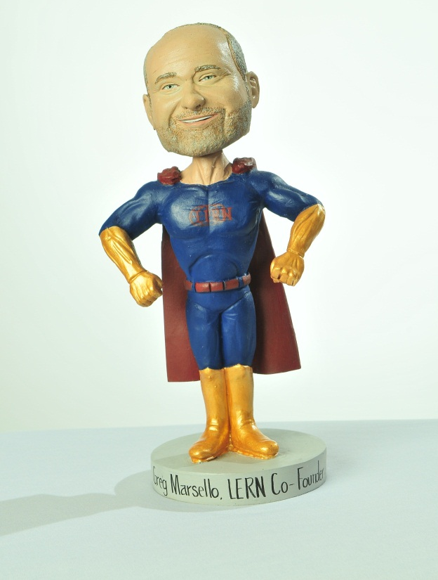
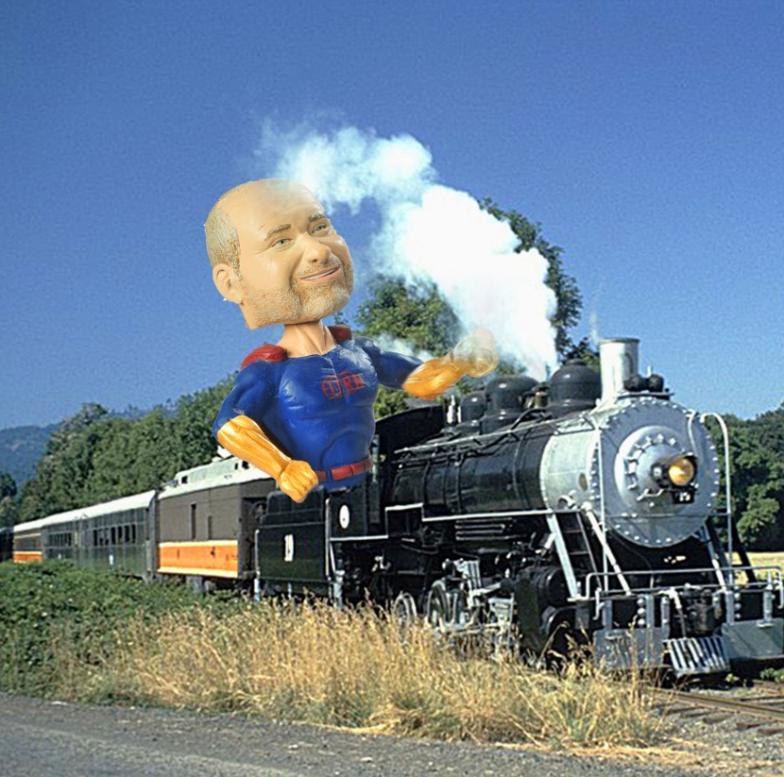
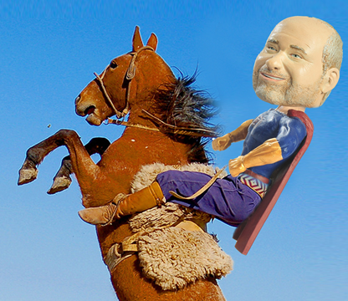
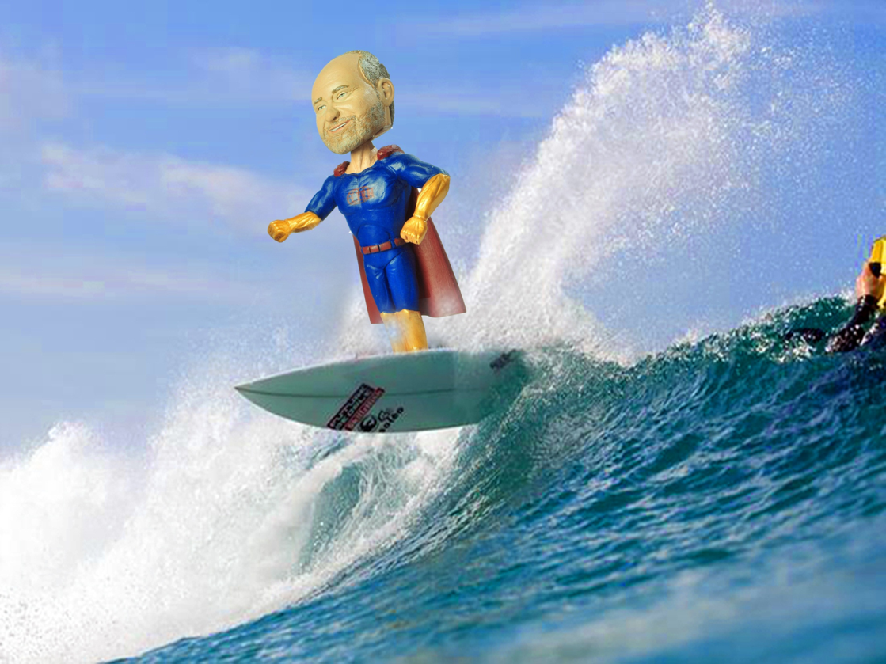


Slide 4


Slide 5


Slide 6
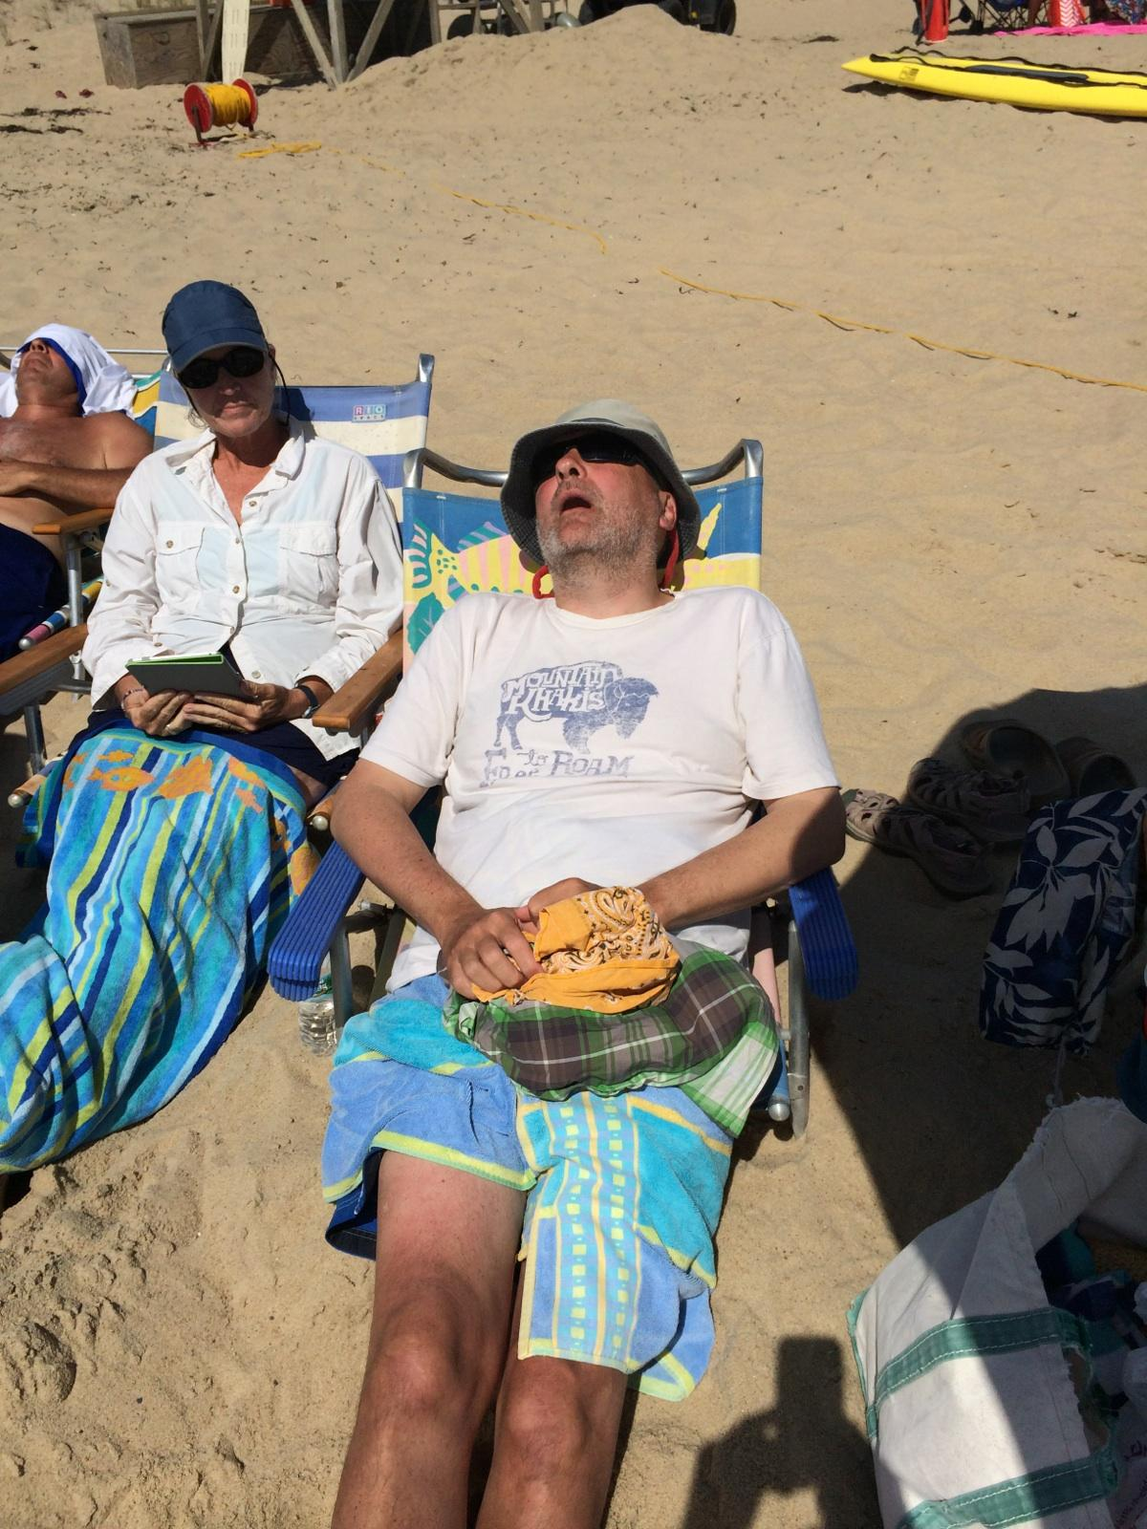

Slide 7
Game changing Trends in CEhy Winners Win

Slide 8
But first…

Slide 9
Projections
25% of the programs LERN works with are winners,
while LERN predicts 25-50% of existing programs will
probably be shut down over the next five to ten years!

Slide 10

Challenges
Economy
Central administration
Staff skills & productivity
Initiatives
Competition
Knowledge
Vision

Slide 11


Slide 12
#1. Financially Self-Sufficient
Income | $ |  | 100%
Promotion | $ |  | 10-15%
Production | $ |  | 45-50%
Direct Costs | $ |  | 60%
Operating Margin | $ |  | 40%
Administration | $ |  | 35%
Net | $ |  | 5%

Slide 13
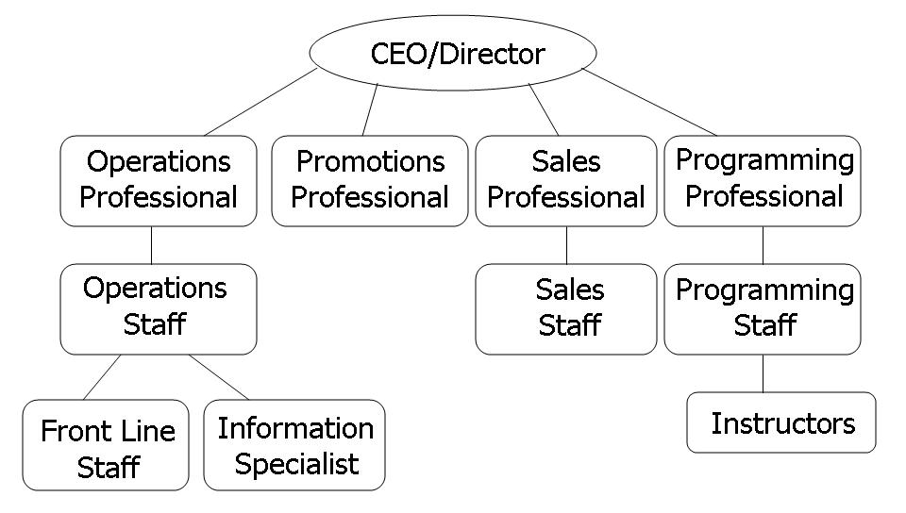
#2. Right Structure & Operating System

Slide 14

#3. Data-Driven Decisions

Slide 15

#4. Best Practices

Slide 16

#5. One-Year & Strategic Planning
Strategic Plan
One-Year Business Plan

Slide 17

#6. Right Software

Slide 18

#7. Visionary & Connected Leadership

Slide 19

20 Most Critical Trends

Slide 20

#1. Jobs

Slide 21
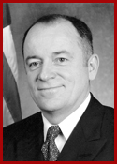
The Intangible Economy
We will have a shortage of 14 – 17 million knowledge workers by 2017.
– Anthony Carnevale, nation’s leading training trends authority formerly with American Society for Training and Development

Slide 22
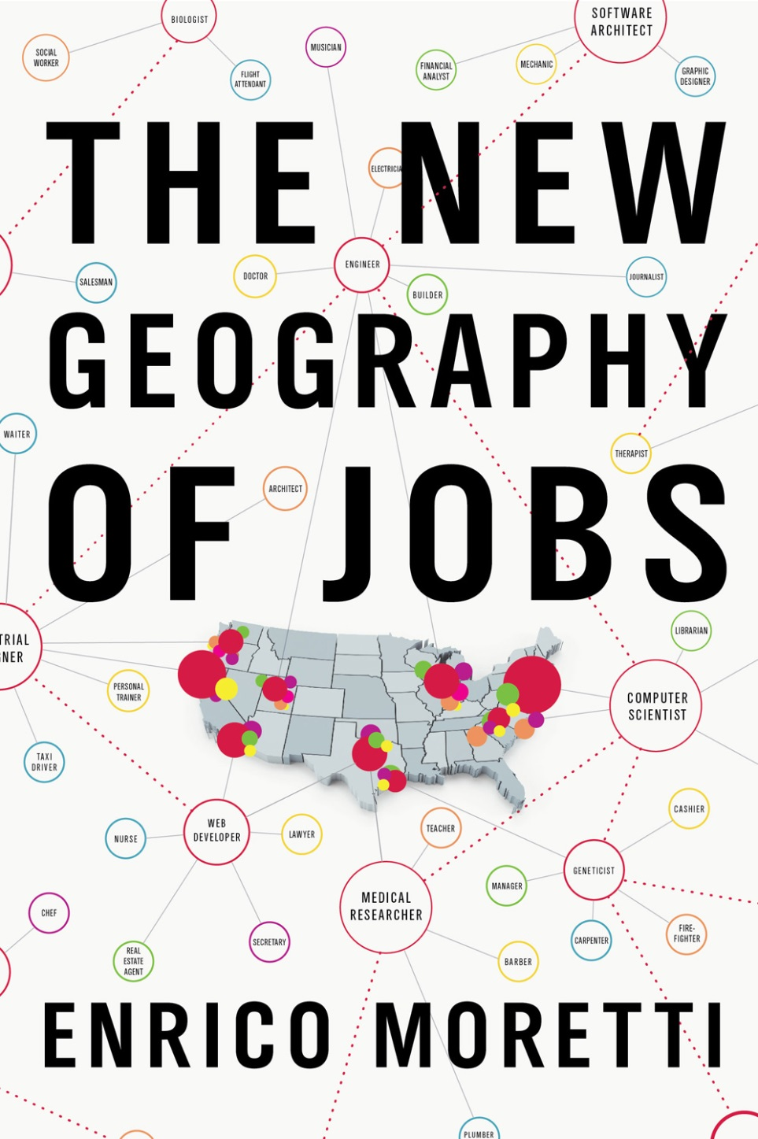
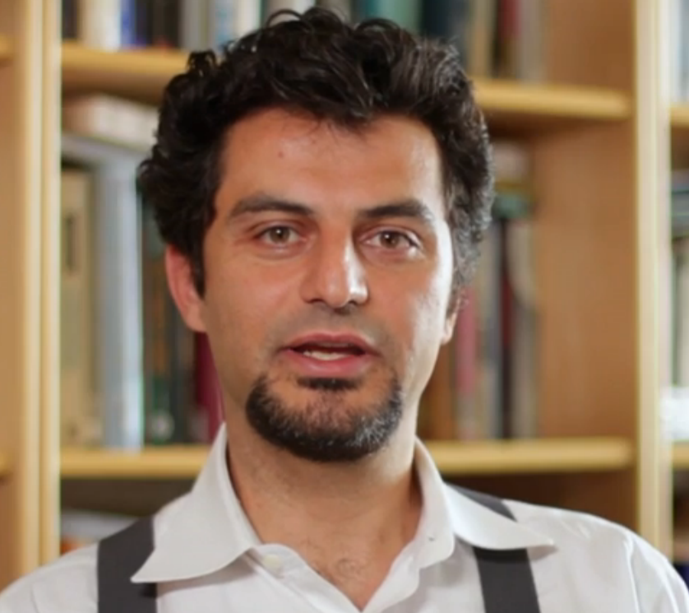

Slide 23
Knowledge Workers
Will earn an average of $100,000 - double what people earn now.
  The national median household income now $53,000.
Knowledge workers create 4 additional local jobs.
Bring income from outside the community.
Make it possible to hire welders, electricians, service workers.

Slide 24
1. The greater percentage of college graduates, more prosperous your community.
2. Even high school graduates do better with more college graduates.
3. Young graduates are moving to areas with more college graduates.

Slide 25

#2. Gen Y Growing in Leadership

Slide 26
Gen Y Landslide
Gay marriage
Marijuana tax
Health insurance
Light rail and trains
Edward Snowden and transparency
$15 an hour minimum wage

Slide 27
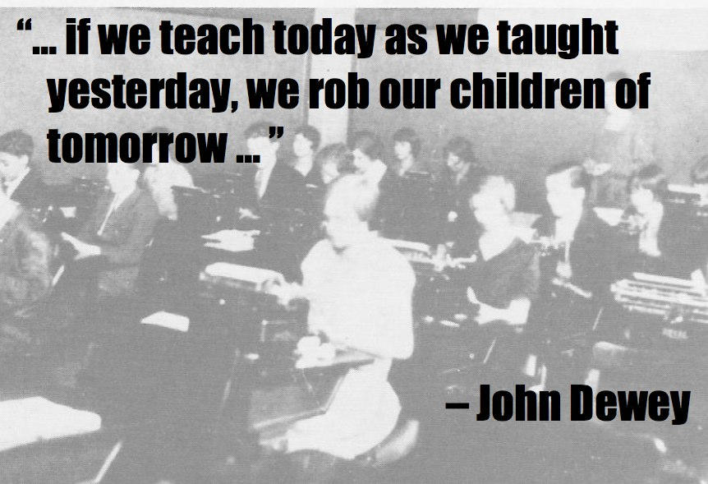
Notes:
ASEE 1893: 110 years
Professionalization and forsaking participation for spectatorship and leisure.
Father: Age 83 still volunteers: Drives DAV Van, serves on Town Planning Commission, Teaches Sunday School
Father-in-law: Worked at Library, Volunteered for Scholarship Committee at Local College, Meals on Wheels
Mother-in-Law: Fund-raises for local historical association, serves as docent on musem board, meals on wheels, church
Progressives like John Dewey was concerned with how to intertwine new technology with face-to-face ties. They recognized the larger new society, they also cherished the smaller, older social networks of neighborhoods:
Dewey Wrote:

Slide 28
In CE Generation Y changes…
Products
  certificate programs
Marketing
  eMarketing and social media
Customer Service
  tablet, phone registration
Delivery
  online and hybrid

Slide 29
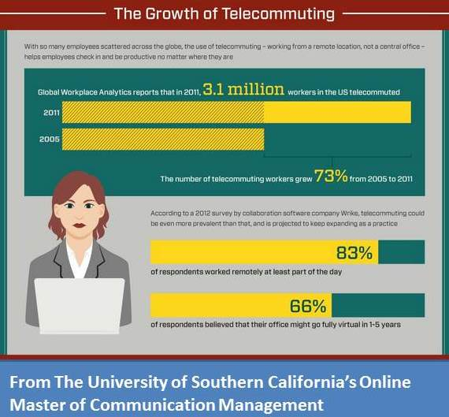
#3. Telecommuting Keeps Growing

Slide 30

#4. The Importance of Business Intelligence

Slide 31

#5. Size Matters: Mergers Pick Up Steam

Slide 32

#6. More CE Units Offering Credit

Slide 33

#7. CEOs Need to Shift from Managers to Visionaries

Slide 34

#8. Shift from Information to Solutions

Slide 35

#9. Focus on Online and Certificates

Slide 36

#10. A Marketing Lesson from the Grateful Dead

Slide 37

#11. Increase Staff Productivity

Slide 38
#12. Create Winning Initiatives
2017
2014
2016
5. Develop/Test
2015

Slide 39

#13. Invest in Product Development

Slide 40

#14. Improve Instructor Quality

Slide 41
#15. Add New Positions
Inbound/outbound marketing
Customer retention
Viral marketing
Social media
Online programming
Hybrid course developer
Software manager
Data analyst

Slide 42
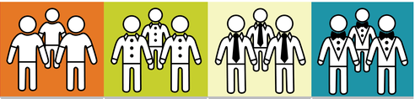
#16. Understand Your Top 2%

Slide 43

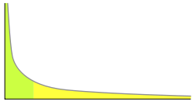

#17. Think Long Tail in Continuing Education
300 or so courses
Thousands of courses, mostly online

Slide 44

#18. Defend Your Program: Be Essential

Slide 45

#19. Know the Winning Mantras

Slide 46

#20. Three Keys for Success
Structure
Software
Operating System

Slide 47
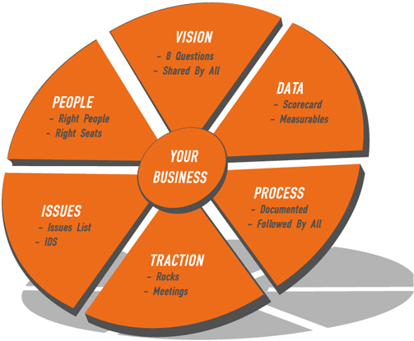
EOS

Slide 48

We Are on the Edge of History

Slide 49
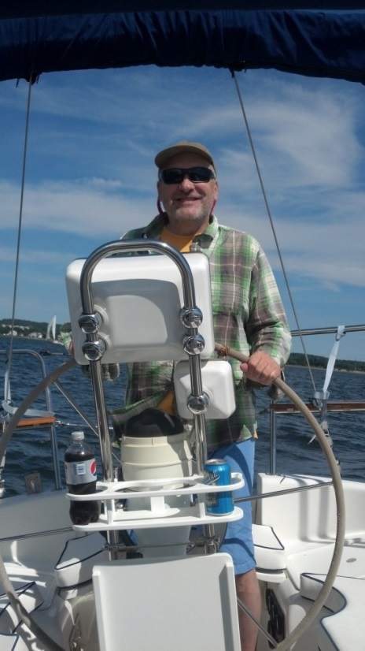
Greg Marsello, LERN
marsello@LERN.org

